Slide 1
System Calls &
API Standards

Slide 2
Contents
Implementation of API
System call types
API Standards
Process Control Calls

Slide 3
System Calls
Previously stated that user applications interact with the
kernel via system calls
• Typically invoked via a trap instruction
An intentional software-generated exception
• The kernel registers a handler for a specific trap
int $0x80 for Linux system calls
int $0x2e for Windows system calls
• Can’t easily pass arguments to system calls on the stack
Trap instruction causes the CPU to switch operating
modes (i.e.from user mode to kernel mode)
Different operating modes have different stacks

Slide 4
System Calls
Typically, arguments to system calls passed in registers,
and the return-value(s) come back in registers
• One of the arguments is an integer indicating which system call to invoke
• e.g. on Linux and Windows, %eax is set to operation to perform
• e.g. on UNIX systems, sys/syscall.h specifies these numbers
• Obvious constraint: system-call arguments can’t be wider than the registers
• Several possible approaches:
• Can split larger arguments across multiple registers
• Can store larger arguments in a struct, then pass a pointer to the
struct as an argument

Slide 5
System Calls
The operating system frequently exposes system calls via
a standard library
• e.g. UNIX syscalls are exposed via the C standard library (libc)
• e.g. Windows syscalls are exposed via the (largely undocumented)
Native API (ntapi.dll)
• The library serves as an intermediary between apps and
the operating system
• Some functions are direct wrappers for system calls
e.g. ssize_t read(int fd, void *buf, size_t nbyte)
Implementation stores arguments from stack into registers, invokes
the system call entry-point (e.g. int $0x80), and returns result
• Others utilize system call wrappers internally
e.g. malloc() is mainly implemented in user space, but uses
system calls to increase the process’ heap size

Slide 6

API – System Call Implementation
The interface to the services provided by the OS has two parts:
  Higher language interface – a part of a system library
    Executes in user mode
    Implemented to accept a standard procedure call
    Traps to the Part 2
  Kernel part
    Executes in system mode
    Implements the required system service
    May cause blocking the caller (forcing it to wait)
    After completion returns back to Part 1 (may report the success or failure of the call)

Slide 7
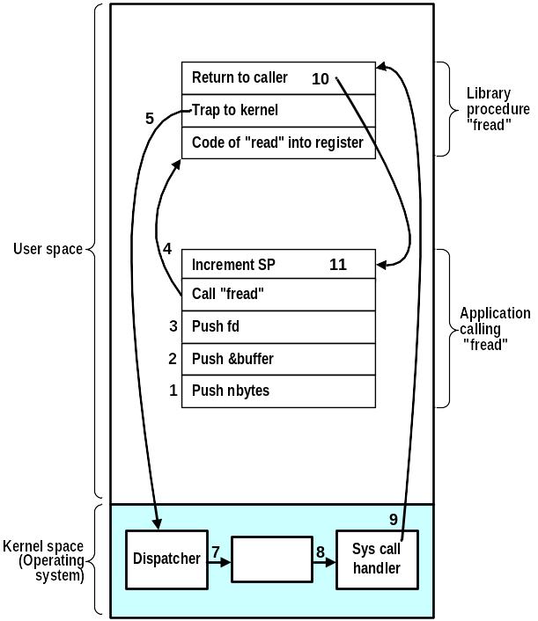
How the System Call Interface is Implemented
The application program makes a System Call:
  A system library routine is called first
  It transforms the call to the system standard (native API) and traps to the kernel
  Control is taken by the kernel running in the system mode
  According to the service “code”, the Call dispatcher invokes the responsible part of the Kernel
  Depending on the nature of the required service, the kernel may block the calling process
  After the call is finished, the calling process execution resumes obtaining the result (success/failure) as if an ordinary function was called
11 steps to execute the service
fread (fd, buffer, nbytes)

Slide 8
System Calls
Programming interface to the services provided by the OS
Typically written in a higher-level language (C or C++)
Mostly accessed by programs via a higher-level Application Program Interface (API) rather than direct system call use
Three most common APIs are Win32 API for Windows, POSIX API for POSIX-based systems (including virtually all versions of UNIX, Linux, and Mac OS X), and Java API for the Java virtual machine (JVM)
Why use APIs rather than the native system calls?

Slide 9
System Call Implementation
Typically, a number associated with each system call
  System-call interface maintains a table indexed according to these numbers
The system call interface invokes intended system call in OS kernel and returns status of the system call and any return values
The caller need know nothing about how the system call is implemented
  Just needs to obey API and understand what OS will do as a result call
  Most details of OS interface hidden from programmer by API
    Managed by run-time support library (set of functions built into libraries included with compiler)

Slide 10
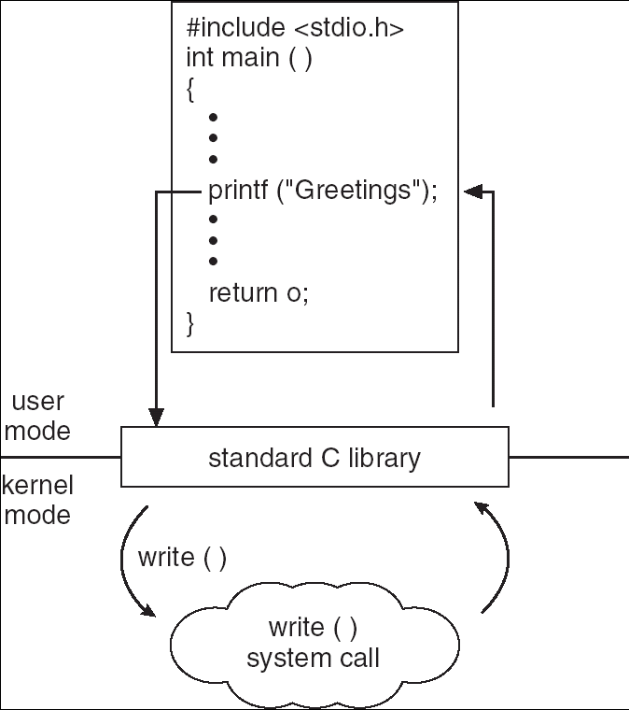
Standard C Library Example
C program invoking printf() library call, which calls write() system call

Slide 11
System API Standards
Three most common API standards are
  POSIX API for POSIX-based systems (including virtually all versions of UNIX, Linux, and Mac OS X)
  Win32 API for Windows
  Java API for the Java virtual machine (JVM)
POSIX (IEEE 1003.1, ISO/IEC 9945)
  Very widely used standard based on (and including) C-language
  Defines both
    system calls and
    compulsory system programs together with their functionality and command-line format
      E.g. ls –w dir prints the list of files in a directory in a ‘wide’ format
  Complete specification is at http://www.opengroup.org/onlinepubs/9699919799/nframe.html
Win32 (Microsoft Windows based systems)
  Specifies system calls together with many Windows GUI routines
    VERY complex, no really complete specification

Slide 12
Parameter passing mechanism
Pass the parameters in Registers
Stored in in memory and the address of the memory is passed as parameter in a register
Parameters are pushed on to the stack by the program and OS can poped off from the stack.

Slide 13
Types of System Calls
A set of (seemingly independent) groups of services:
Process control and IPC (Inter-Process Communication)
Memory management
  allocating and freeing memory space on request
Access to data in files
File and file-system management
Device management
Communications
  Networking and distributed computing support
Other services
  e.g., profiling
  debugging
  etc.

Slide 14
Process Control Calls (1)
fork() – create a new process
pid = fork();
  The fork() function shall create a new process. The new process (child process) shall be an exact copy of the calling process (parent process) except some process’ system properties
  It returns ‘twice’
    return value == 0 ... child
    return value > 0 ... parent (returned value is the child’s pid)
exit() – terminate a process
void exit(int status);
  The exit() function shall then flush all open files with unwritten buffered data and close all open files. Finally, the process shall be terminated and system resources owned by the process shall be freed
  The value of ‘status’ shall be available to a waiting parent process
  The exit() function should never return

Slide 15
Process Control Calls (2)
wait, waitpid – wait for a child process to stop or terminate
pid = wait(int *stat_loc);
pid = waitpid(pid_t pid, int *stat_loc, int options);
  The wait() and waitpid() functions shall suspend the calling process and obtain status information pertaining to one of the caller's child processes. Various options permit status information to be obtained for child processes that have terminated or stopped.
execl, execle, execlp, execv, execve, execvp – execute a file
int execl(const char *path, const char *arg0, ...);
  The members of the exec family of functions differ in the form and meaning of the arguments
  The exec family of functions shall replace the current process image with a new process image. The new image shall be constructed from a regular, executable file called the new process image file.
  There shall be no return from a successful exec, because the calling process image is overlaid by the new process image; any return indicates a failure

Slide 16
Process Control Calls- Sample program
Int main()
{ pid_t pid1, pid2;
int i=10;
pid1= fork();
if(pid1==0){
i=i+5;
printf(“%d”, i)
}
i=i+20;
Printf(“%d”, i);
}

Slide 17
Memory Management Calls
System calls of this type are rather obsolete
  Modern virtual memory mechanisms can allocate memory automatically as needed by applications
  Important system API calls are:
malloc() – a memory allocator
void *malloc(size_t size);
  The malloc() function shall allocate unused space for an object whose size in bytes is specified by size and whose value is unspecified.
  It returns a pointer to the allocated memory space
free() – free a previously allocated memory
void free(void *ptr);
  The free() function shall cause the space pointed to by ptr to be deallocated; that is, made available for further allocation.
  If the argument does not match a pointer earlier returned by a malloc() call, or if the space has been deallocated by a call to free(), the behavior is undefined.

Slide 18
File Access Calls (1)
POSIX-based operating systems treat a file in a very general sense
  File is an object that can be written to, or read from, or both. A file has certain attributes, including access permissions and type.
  File types include
    regular file,
    character special file ... a ‘byte oriented device’,
    block special file ... a ‘block oriented device’,
    FIFO special file,
    symbolic link,
    socket, and
    directory.
  To access any file, it must be first opened using an open() call that returns a file descriptor (fd).
    fd is a non-negative integer used for further
    reference to that particular file
    In fact, fd is an index into a process-owned
    table of file descriptors
    Any open() (or other calls returning fd) will
    always assign the LOWEST unused entry
    in the table of file descriptors
STDIN
0
STDOUT
1
STDERR
2
3
NULL
4
NULL
5

Slide 19
File Access Calls (2)
open – open file
fd = open(const char *path, int oflag, ...);
  The open() function shall establish the connection between a file and a file descriptor. The file descriptor is used by other I/O functions to refer to that file. The path argument points to a pathname naming the file.
  The parameter oflag specifies the open mode:
    ReadOnly, WriteOnly, ReadWrite
    Create, Append, Exclusive, ...
close – close a file descriptor
err = close(int fd);
  The close() function shall deallocate the file descriptor indicated by fd. To deallocate means to make the file descriptor available for return by subsequent calls to open() or other functions that allocate file descriptors.
  When all file descriptors associated with an open file description have been closed, the open file description shall be freed.

Slide 20
File Access Calls (3)
read – read from a file
b_read = read(int fd, void *buf, int nbyte);
  The read() function shall attempt to read nbyte bytes from the file associated with the open file descriptor, fd, into the buffer pointed to by buf.
  The return value shall be a non-negative integer indicating the number of bytes actually read.
write – write to a file
b_written = write(int fd, void *buf, int nbyte);
  The write() function shall attempt to write nbyte bytes from the buffer pointed to by buf to the file associated with the open file descriptor fd.
  The return value shall be a non-negative integer indicating the number of bytes actually written.

Slide 21
File Access Calls (4)
lseek – move the read/write file offset
where = lseek(int fd, off_t offset, int whence);
  The lseek() function shall set the file offset for the open associated with the file descriptor fd, as follows:
    If whence is SEEK_SET, the file offset shall be set to offset bytes.
    If whence is SEEK_CUR, the file offset shall be set to its current location plus offset.
    If whence is SEEK_END, the file offset shall be set to the size of the file plus offset.
  The lseek() function shall allow the file offset to be set beyond the end of the existing data in the file creating a gap. Subsequent reads of data in the gap shall return bytes with the value 0 until some data is actually written into the gap (implements sparse file).
  Upon successful completion, the resulting offset, as measured in bytes from the beginning of the file, shall be returned.
  An interesting use is:
where = lseek(int fd, 0, SEEK_CUR);
will deliver the “current position” in the file.

Slide 22
File Access Calls (5)
dup – duplicate an open file descriptor
fd_new = dup(int fd);
  The dup() function shall duplicate the descriptor to the open fileassociated with the file descriptor fd.
  As for open(), the LOWEST unused file descriptor should be returned.
  Upon successful completion a non-negative integer, namely the file descriptor, shall be returned; otherwise, -1 shall be returned to indicate the error.
stat – get file status
err = stat(const char path, struct stat *buf);
  The stat() function shall obtain information about the named file and write it to the area pointed to by the buf argument. The path argument points to a pathname naming a file. The file need not be open.
  The stat structure contains a number of important items like:
    device where the file is, file size, ownership, access rights, file time stapms, etc.

Slide 23
File Access Calls (6)
chmod – change mode of a file
err = chmod(const char *path, mode_t mode);
  The chmod() function shall the file permission of the file named by the path argument to the in the mode argument. The application shall ensure that the effective privileges in order to do this.
pipe – create an interprocess communication channel
err = pipe(int fd[2]);
  The pipe() function shall create a pipe and place two file descriptors, one each into the arguments fd[0] and fd[1], that refer to the open file descriptors for the read and write ends of the pipe. Their integer values shall be the two lowest available at the time of the pipe() call.
  A read on the file descriptor fd[0] shall access data written to the file descriptor fd[1] on a first-in-first-out basis.
  The details and utilization of this call will be explained later.

Slide 24
File & Directory Management Calls (1)
mkdir – make a directory relative to directory file descriptor
err = mkdir(const char *path, mode_t mode);
  The mkdir() function shall create a new directory with name path. The new directory access rights shall be initialized from mode.
rmdir – remove a directory
err = rmdir(const char *path);
  The rmdir() function shall remove a directory whose name is given by path. The directory shall be removed only if it is an empty directory.
chdir – change working directory
err = chdir(const char *path);
  The chdir() function shall cause the directory named by the pathname pointed to by the path argument to become the current working directory. Working directory is the starting point for path searches for relative pathnames.

Slide 25
File & Directory Management Calls (2)
link – link one file to another file
err = int link(const char *path1, const char *path2);
  The link() function shall create a new link (directory entry) for the existing file identified by path1.
unlink – remove a directory entry
err = unlink(const char *path);
  The unlink() function shall remove a link to a file.
  When the file's link count becomes 0 and no process has the file open, the space occupied by the file shall be freed and the file shall no longer be accessible. If one or more processes have the file open when the last link is removed, the link shall be removed before unlink() returns, but the removal of the file contents shall be postponed until all references to the file are closed.
chdir – change working directory
err = chdir(const char *path);
  The chdir() function shall cause the directory named by the pathname pointed to by the path argument to become the current working directory. Working directory is the starting point for path searches for relative pathnames.

Slide 26
Device Management Calls
System calls to manage devices are hidden into ‘file calls’
  POSIX-based operating systems do not make difference between traditional files and ‘devices’. Devices are treated as ‘special files’
  Access to ‘devices’ is mediated by opening the ‘special file’ and accessing it through the device.
  Special files are usually ‘referenced’ from the /dev directory.
ioctl – control a device
  int ioctl(int fd, int request, ... /* arg */);
  The ioctl() function shall perform a variety of control functions on devices. The request argument and an optional third argument (with varying type) shall be passed to and interpreted by the appropriate part of the associated with fd.

Slide 27
Other Calls
kill – send a signal to a process or a group of processes
  err = kill(pid_t pid, int sig);
  The kill() function shall send a signal to a process specified by pid. The signal to be sent is specified by sig.
  kill() is an elementary inter-process communication means
  The caller has to has to have sufficient privileges to send the signal to the target.
signal – a signal management
  void (*signal(int sig, void (*func)(int)))(int);
  The signal() function chooses one of three ways in which receipt of the signal sig is to be subsequently handled.
    If the value of func is SIG_DFL, default handling for that signal shall occur.
    If the value of func is SIG_IGN, the signal shall be ignored.
    Otherwise, the application shall ensure that func points to a function to be called when that signal occurs. An invocation of such a function is called a "signal handler".

Slide 28
POSIX and Win32 Calls Comparison
Only several important calls are shown
POSIX | Win32 | Description
fork | CreateProcess | Create a new process
wait | WaitForSingleObject | The parent process may wait for the child to finish
execve | -- | CreateProcess = fork + execve
exit | ExitProcess | Terminate process
open | CreateFile | Create a new file or open an existing file
close | CloseHandle | Close a file
read | ReadFile | Read data from an open file
write | WriteFile | Write data into an open file
lseek | SetFilePointer | Move read/write offset in a file (file pointer)
stat | GetFileAttributesExt | Get information on a file
mkdir | CreateDirectory | Create a file directory
rmdir | RemoveDirectory | Remove a file directory
link | -- | Win32 does not support “links” in the file system
unlink | DeleteFile | Delete an existing file
chdir | SetCurrentDirectory | Change working directory

